Slide 1


OBJECT ORIENTED PROGRAMMING THROUGH JAVA

Slide 2

L9-OPERATORS

Slide 3


Slide 4
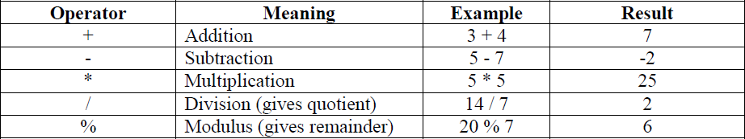
OPERATORS:-
An operator is a symbol that performs an operation. An operator acts on variables called operands.
Arithmetic operators: These operators are used to perform fundamental operations like addition, subtraction, multiplication etc.

Slide 5
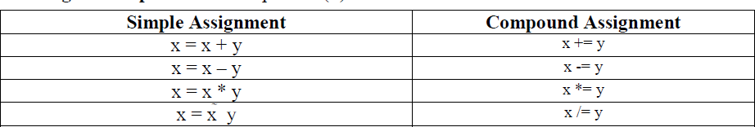
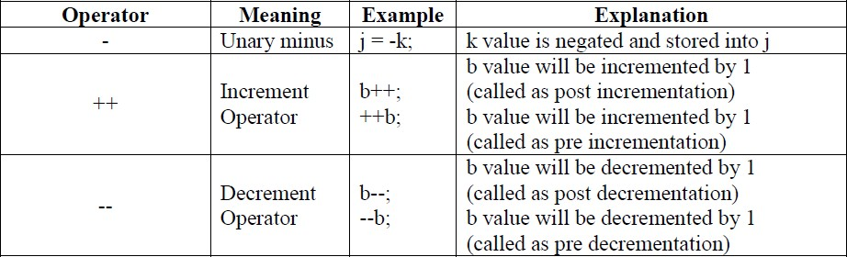
Assignment operator: This operator (=) is used to store some value into a variable.
Unary operators: As the name indicates unary operator’s act only on one operand.

Slide 6
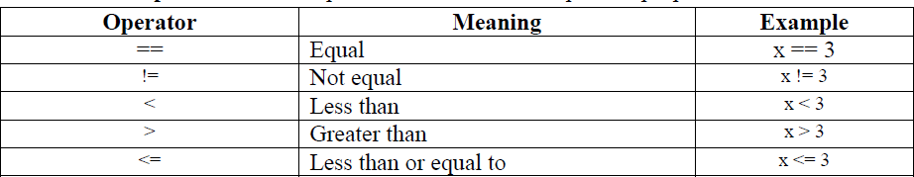
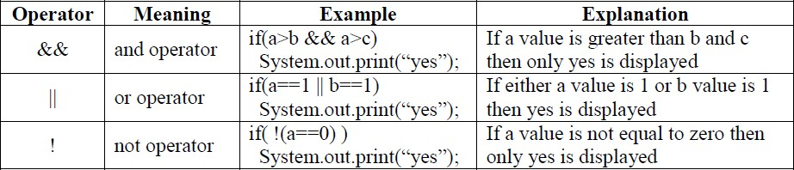
Relational operators: These operators are used for comparison purpose.
Logical operators: Logical operators are used to construct compound conditions. A compound condition is a combination of several simple conditions.

Slide 7
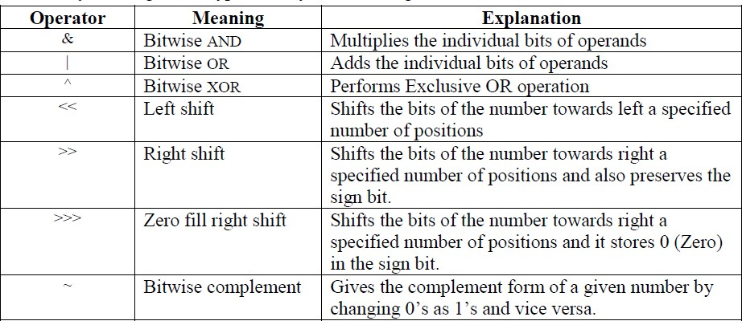
Bitwise operators: These operators act on individual bits (0 and 1) of the operands. They act only on integer data types, i.e. byte, short, long and int.

Slide 8
Ternary Operator or Conditional Operator (? :):
This operator is called ternary because it acts on 3 variables. The syntax for this operator is: Variable = Expression1? Expression2: Expression3;
First Expression1 is evaluated. If it is true, then Expression2 value is stored into variable otherwise Expression3 value is stored into the variable.
e.g.: max = (a>b) ? a: b;

Slide 9

Program 1: Write a program to perform arithmetic operations
//Addition of two numbers class AddTwoNumbers
{ public static void mian(String args[])
{ int i=10, j=20;
System.out.println("Addition of two numbers is : " + (i+j)); System.out.println("Subtraction of two numbers is : " + (i-j)); System.out.println("Multiplication of two numbers is : " + (i*j)); System.out.println("Quotient after division is : " + (i/j) ); System.out.println("Remainder after division is : " +(i%j) );
}}
Program 2: Write a program to perform Bitwise operations
//Bitwise Operations class Bits
{ public static void main(String args[])
{ byte x,y; x=10; y=11;
System.out.println ("~x="+(~x)); System.out.println ("x & y="+(x&y)); System.out.println ("x | y="+(x|y)); System.out.println ("x ^ y="+(x^y)); System.out.println ("x<<2="+(x<<2)); System.out.println ("x>>2="+(x>>2)); System.out.println ("x>>>2="+(x>>>2));
}
}

Slide 10

Next….
CONTROL STATEMENTS
Notes:
In Slide Show mode, click the arrow to enter the PowerPoint Getting Started Center.

Slide 11



